Slide 1
Life Expectancy Prediction
CSCI-B565
DATA MINING
Chandana Chakilam - schakil@iu.edu
Laxmi Soujanya Taduru - ltaduru@iu.edu
INDIANA UNIVERSITY BLOOMINGTON

Slide 2

Problem Statement​
Many studies in the past have taken multiple factors into consideration to understand and analyze the life expectancy of people in a country but overlooked the importance of human development index, immunization, mortality, economic and other health related factors.​
This project contributes to analyze and understand the factors that influence the life span of the population of several countries and proposing different algorithms and comparing their efficiency and performance in a Kaggle dataset.​

Slide 3

Real World Problem​
Life expectancy gauges the overall health of a community, there by giving the scope of improving several factors that affect it.
In the past few years, there has been a huge improvement in the medical sector which has impacted the average age of death of population. This also resulted in the overall improvement of human mortality rate, especially in the developing countries.
However, the factors affecting this were not completely analyzed. The effect of alcohol consumption, immunization like Hepatitis, Diphtheria and Measles, GDP of a country have a larger role than expected.​

Slide 4

Dataset Information​
The dataset for this project is available on Kaggle. It consists of 2938 rows with 22 columns.
Life expectancy being the target variable and 21 predictor variables.
The project relies on the accuracy of the data. This dataset has been made available by World Health Organization (WHO) for health analysis purposes.
It contains data from the year 2000-2015 for 193 countries for further analysis.

Slide 5

Methodology
Following are the main components, in our proposed methodology:
Preprocessing the dataset
Data Visualization
Model implementation
Accuracy metrics analysis

Slide 6
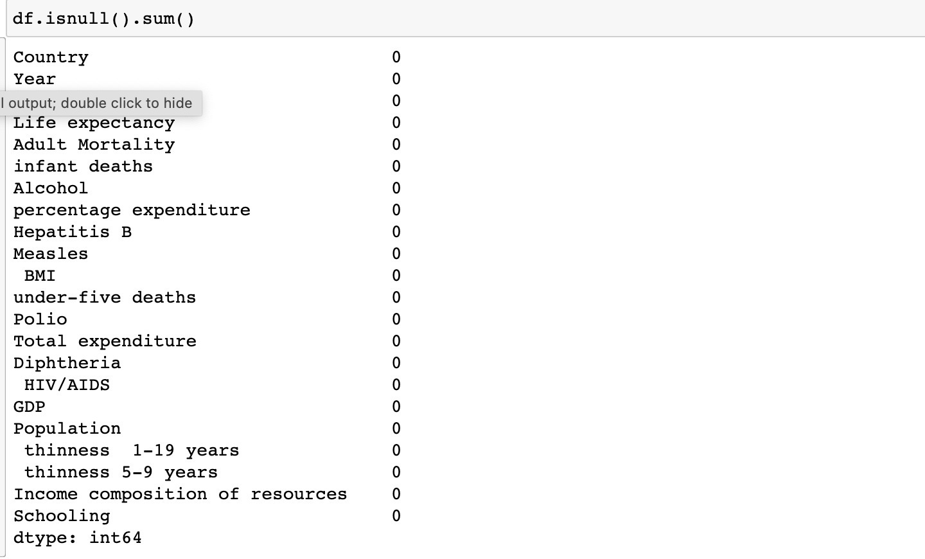
Data Preprocessing​
Check if there are any duplicates.​
Check if there are any null values.​
Handle the null values by filling them with mean values.​
For easy access, rename the column names by removing extra spaces and placing underscores.

Slide 7
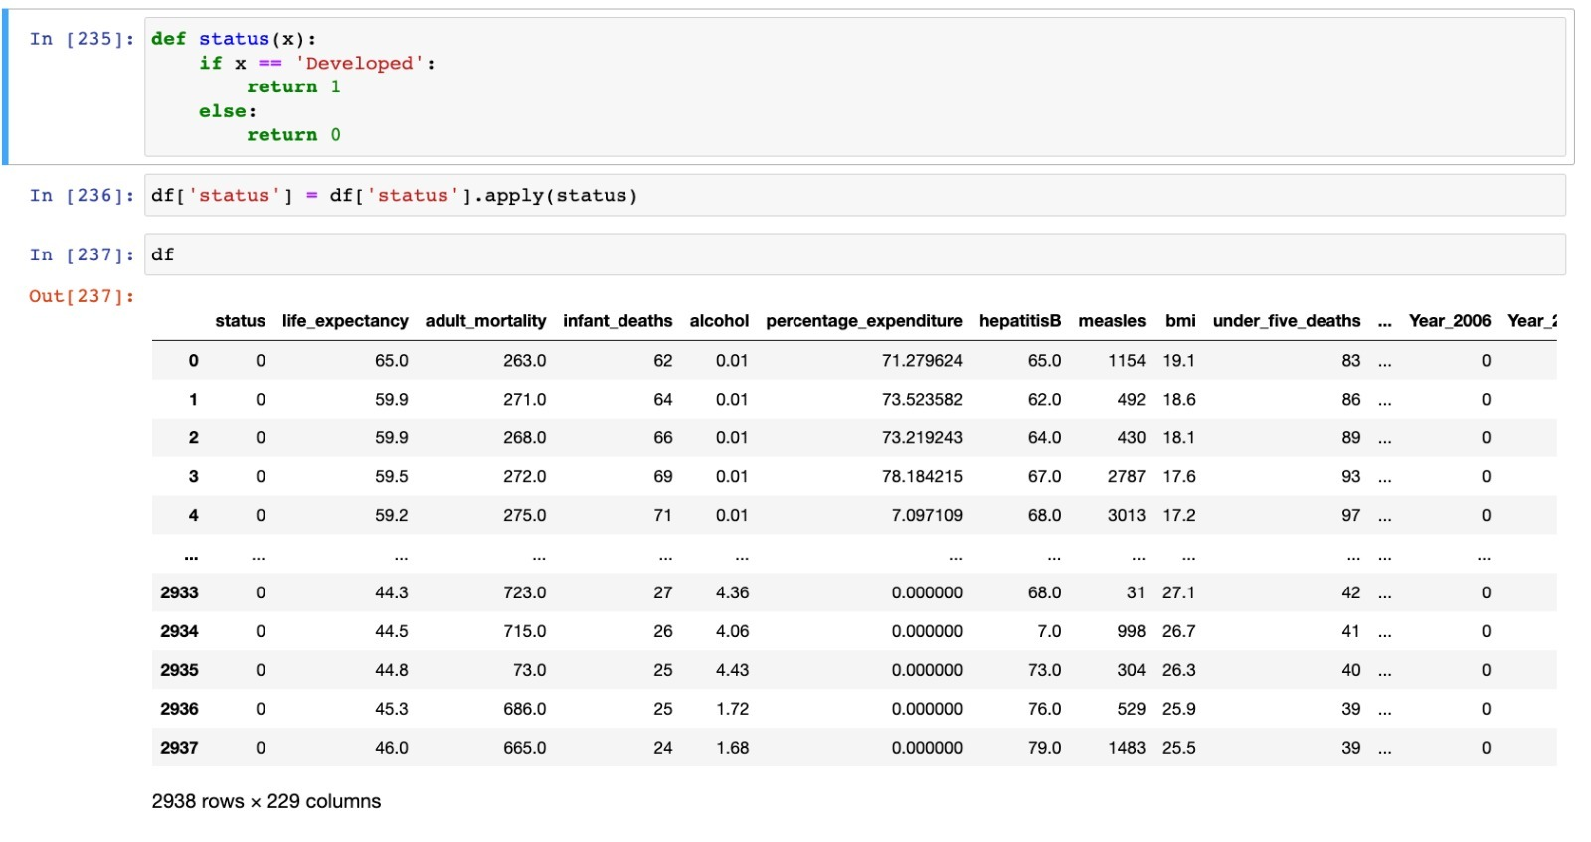
Data Preprocessing​
There are two object based attributes(‘Status’, ‘Country’) in the dataset. To apply the training models, these attributes must be handled.
Since the column- ‘Status’ is a categorical attribute with only two values(‘Developing’ and ‘Developed’), it can be replaced with values ‘0’ and ‘1’.

Slide 8
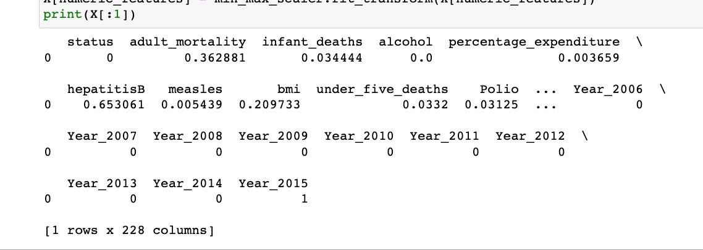
Since the column - ‘Country’ is a nominal attribute with 192 values, it can be handled using Feature Encoding.
It converts categorical data into dummy or indicator variables, that can be used to feed the regressor models.
A similar manipulation technique has been used on the column - ‘Year’.

Slide 9
Data Visualization ​
Some observations:
Using correlation analysis, the variables that impact the predictor variable can be found. ​
The target variable (in our case ‘life_expectancy’) has a positive correlation with predictor variables columns like ‘schooling’ and ‘Income composition of resources’, ‘thinness_1to19_years’ and ‘thinness_5to9_years’. ​
Similarly, it has a negative correlation with predictor variables columns like ‘adult mortality’.​
The life expectancy for developed countries is more than the developing countries.

Slide 10
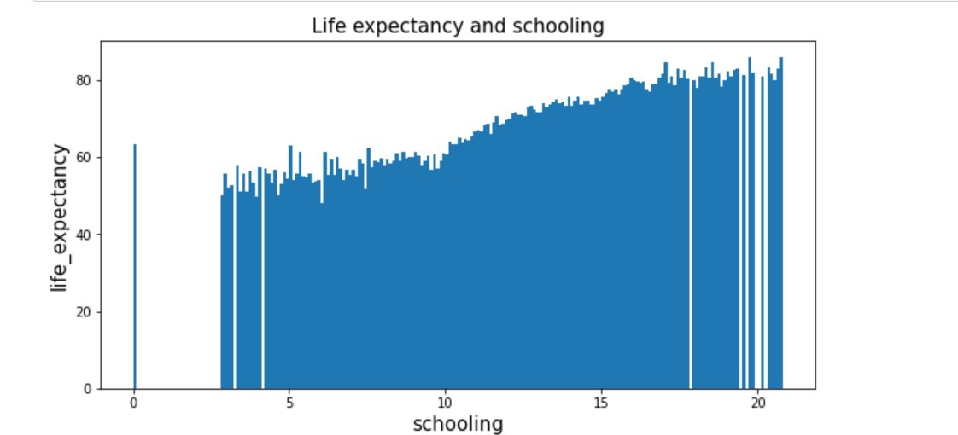
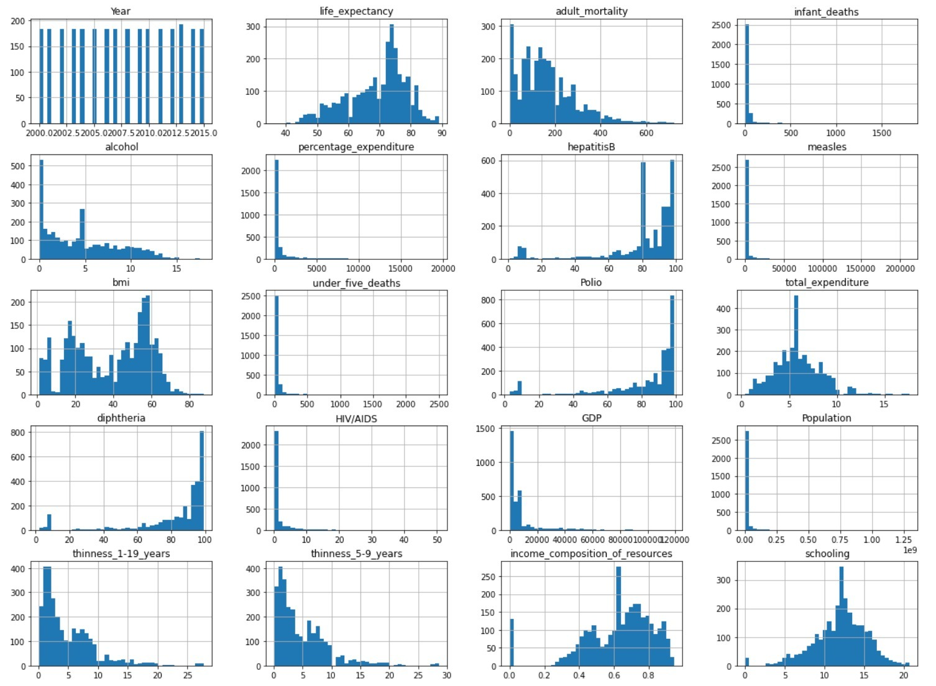
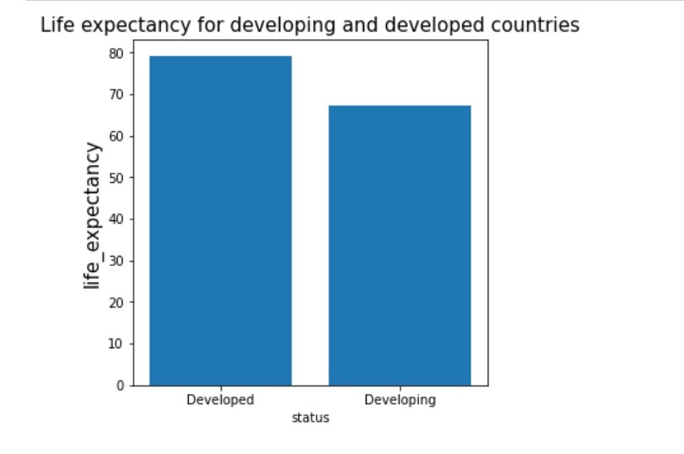
Data Visualization ​

Slide 11
Normalization
The scale of data for some features may be significantly different from those of others.
This may harm the performance of our models.
Using Min-max scaling, we can limit the data values of a column to a specific range using each column’s minimum and maximum value.
We shall apply this to all the numeric attributes in our dataset.

Slide 12
Models
Following models have been implemented in this project:
Linear Regression
Ridge Regression
Decision Tree
Adaboost
XGBoost

Slide 13
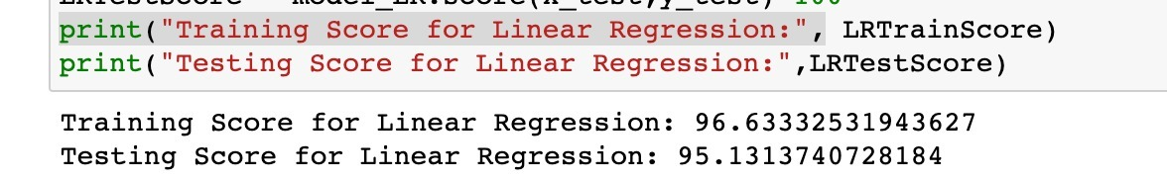
Model- Linear Regression
Linear Regression is used to model the relationship between predictor and target variables.
The target variable must be continuous.

Slide 14
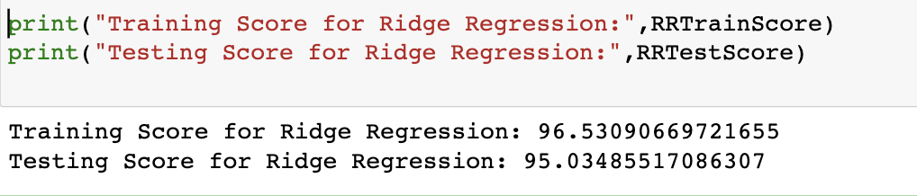
Model - Ridge Regression
Ridge regression can be used when there is multicollinearity in the dataset or when the number of predictor variables is higher than the number of observations.
This method performs L2 regularization.

Slide 15
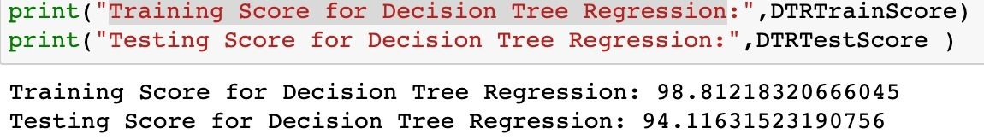
Model- Decision Tree Regression
Numerical values can be handled by decision trees. It gradually builds an associated decision tree while dividing a dataset into smaller and smaller sections.

Slide 16
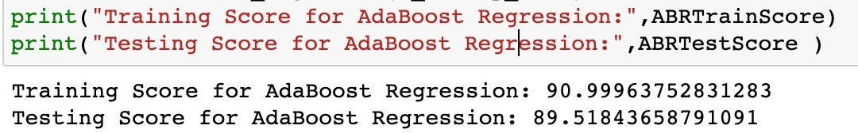
Model - ADABOOST
AdaBoost stands for Adaptive boosting, is a meta-algorithm, which enables performance enhancement when combined with other algorithms.
It starts by fitting one regressor on the original dataset, and then it fits subsequent copies of the regressor on the same dataset with the weights of the instances being changed in accordance with the error of the most recent prediction. As a result, successive regressors concentrate more on challenging cases.

Slide 17
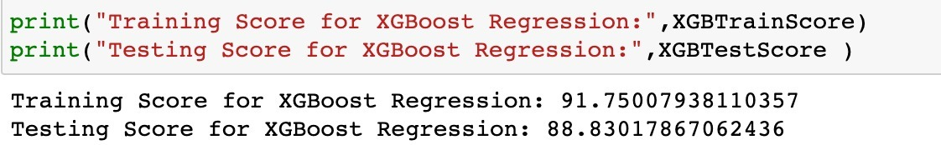
Model - XGBoost
XGBoost stands for “Extreme Gradient Boosting”.
It can be used directly for regression predictive modeling.

Slide 18
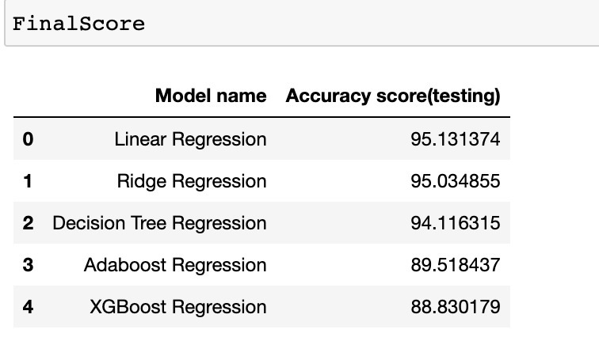
Results:

Slide 19
References
[1] Dataset - https://www.kaggle.com/datasets/kumarajarshi/life-expectancy-who
[2] Adaboost - https://scikit-learn.org/stable/modules/generated/sklearn.ensemble.AdaBoostClassifier.html
[3] Linear regression- https://scikit-learn.org/stable/modules/generated/sklearn.linear_model.LinearRegression.html
[4] Decision Tree regression - https://scikit-learn.org/stable/modules/generated/sklearn.tree.DecisionTreeRegressor.html
[5] Ridge regression - https://scikit-learn.org/stable/modules/generated/sklearn.linear_model.Ridge.html
[6] Feature Engineering - https://www.projectpro.io/article/8-feature-engineering-techniques-for-machine-learning/423
[7] XGBoost Regression - https://xgboost.readthedocs.io/en/stable/python/python_api.html

Slide 20
THANK YOU

